Slide 1
AERO 999
Independent Research
Weekly Status Update
Lt Col Nidal Jodeh
29 Jan 2014

Slide 2
Overview
Review Task
Status update
Upcoming Conferences/Papers
Research Review Status
Calendar Review
Open Topics

Slide 3
Status Update
Accomplishments since last meeting
2013 DoD UAV Roadmap
Masternak, Smith, and Suplisson Prospectus
Started Prospectus document
Using Cade’s Template in LaTex
Notes:
o

Slide 4
Follow Up From Last Meeting
Based on AFRL: “Autonomous Cooperative Collaborative Multi Vehicle Concentrated Search”
Start lit search on multiple vehicle simultaneous optimization
Increase search to multiple vehicles
No limit on UAV search area, let the optimizer figure that out
Number of vehicles should be a user input
Can I assign different integral constraints to individual UGS?
Is there a processing penalty that will get quickly out of hand?
Based on UGS data:
Asses incoming UGS data – Identify areas of high activity (need to define “high activity”)
Re-optimize search to ‘concentrate’ more on areas of high activity (defined by some higher number of UGS alarms)

Slide 5
Upcoming Tasks
In current GPOPS II Code
Non-Dimensionalize
Figure out multiple vehicles
GPOPS II Example
Continue to write prospectus document
Lit search
Adaptive constraint assignment …
Collaborative
Optimal Autonomous Search Pattern
Autonomous Control Cooperative Collaborative Multi Vehicle Concentrated Search
Path Trajectory
Multi Vehicle search by Booth
Get any added literature from Derrick.
Place Prospectus Template on L Drive Research Cobb Thesis Templates
Jaques – LOCAS work?

Slide 6
Calendar Review
Proposed:
May/June? - Prospectus Defense
Include solution for multivehicle in GPOPS as an example
Post prospectus? - Journal Submissions (GNC),
IEEE – Automatica
AUVSI –
AFM -
Known:
4-5 in Denver … Maybe?
4 Feb – Dr Rao’s visit
14 Feb – AFRL Autonomy Roadmap
5 Mar – DCASS
May – AFRL Flight test
June - SciTech 2015 Abstracts Due
August – AFRL Flight test

Slide 7
Research Question Review
How to formulate the multiple airborne agent concentrated search of ground sensor array problem as an optimal control problem?
How to model and estimate stochastic intruder(s) for an Airborne Collision Avoidance Application in the Optimal Control Problem?
How to account for ownship and intruder(s) uncertainties for an Airborne Collision Avoidance Application in the Optimal Control Problem?

Slide 8
Task Review (1/3)
Task 1: Evaluate Alternate Nonlinear Estimation Filtering Techniques
Background: Develop and evaluate alternate nonlinear filtering techniques to the Extended Kalman Filter (EKF) currently implemented in MuSICA. Designers initially selected the EKF due to the combination of “good tracking performance and reasonable computation requirements” [1]. However, robust analysis demonstrated that the EKF’s “linear approximation of nonlinear measurements” leaves room for “potential improvements” in estimation accuracy [1].
T1.1: Conduct research to quantify the performance gained by using alternate nonlinear filtering techniques such as the Unscented Kalman Filter (UKF) and the particle filter.

Slide 9
Task Review (2/3)
Task 2: Develop Maneuvering Intruder Trajectory Prediction
Background: The current “intruder trajectory prediction” assumes a non-maneuvering intruder. The algorithm assumes the intruder’s acceleration is “a zero-mean white Gaussian process which implies that the intruder is effectively non-maneuvering but with uncertainty” [1].
T2.1: Conduct research to develop different classes of maneuvering trajectories and then quantify the increased system performance gained by accurately modeling a maneuvering intruder. The classes of maneuvering trajectories will include turns, level flight, and altitude changes with the sponsor prioritizing the trajectories analyzed for this research.
T2.2: Investigate alternative methods to determine optimal collision avoidance trajectories based on intruder dynamics and uncertainties associated with the intruder’s position and trajectory.

Slide 10
Task Review (3/3)
Task 3: Evaluate Alternate Data Association Algorithms
Background: The MuSICA algorithm currently employs the Jonker-Volgenant-Castanon (JVC) data association algorithm. The main disadvantage to the JVC algorithm is that its choice of association “may be ambiguous especially in dense target or clutter environments” [1].
T3.1: Conduct research to quantify the performance gained in dense target or clutter environments from using alternate data association algorithms such as the joint probabilistic data association (JPDA) and the multiple hypothesis tracking (MHT) algorithms.

Slide 11
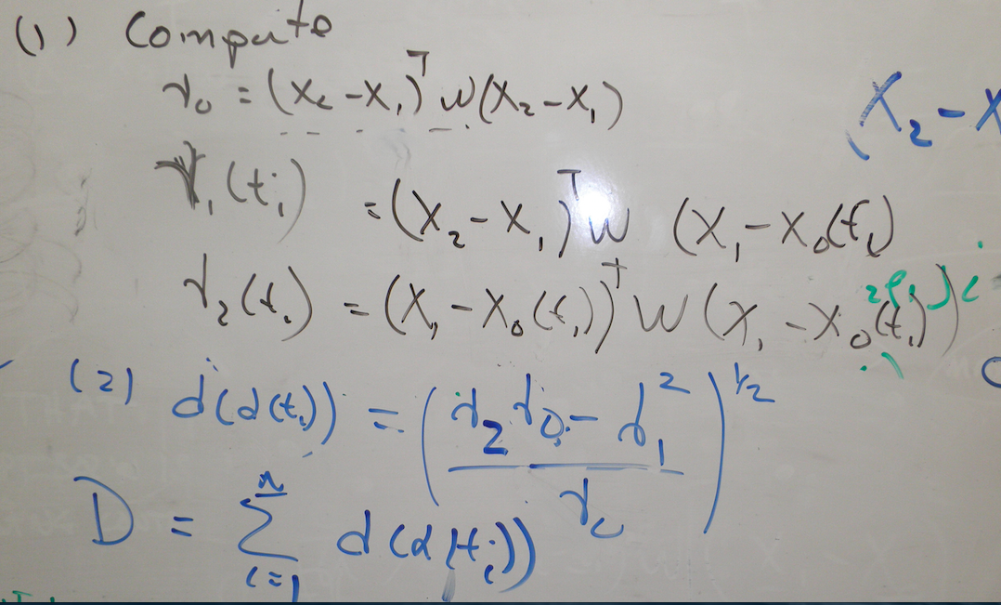
Discussion
Paper AIAA Brief for AFRL
Ask about 2 references
Original distance formula
New weighted distance:

Slide 12
Discussion
Paper review
Should I include previous abstract info?
Include 2D turn model results?
Plan to include items on subsequent chart
Plan to show 2-ship avoidance
Flight test data not representative
linear so nonlinear propagation model not necessary
ADSB data is linear so only need Kalman filter

Slide 13
Conferences/Papers
2014 AIAA SciTech Forum & Exposition (13 – 17 Jan 2014)
National Harbor, Maryland (15 minutes from D.C)
Paper submission deadline: 12/12/2013
Resubmit final correction 12/30/2013
39th AIAA DCASS 2014 Abstract due 13 January, 2014 -
Abstracts received by the final deadline of 20 January, 2014 will be considered based on abstract quality and symposium need.
Submit AIAA Journal Article from combined conference papers
Submit “Technical Note” for ellipsoid capture algorithm?

Slide 14
Follow up from last week
Will add higher order ellipsoid (4th order)
Remove final control and use final Radau control for next iteration
Scale all control to -0.5 to 0.5

Slide 15
Notes
Save .fig files for Matlab® to recreate figures quickly
Note: How ODE45 works. Include routine here from Numerical Recipe book
Schematic of what I am doing to incorporate stochastic intruder; most others put stochastic inside OCP.
Intruder Model
Optimal Control Problem
Nonlinear Filter

Slide 16
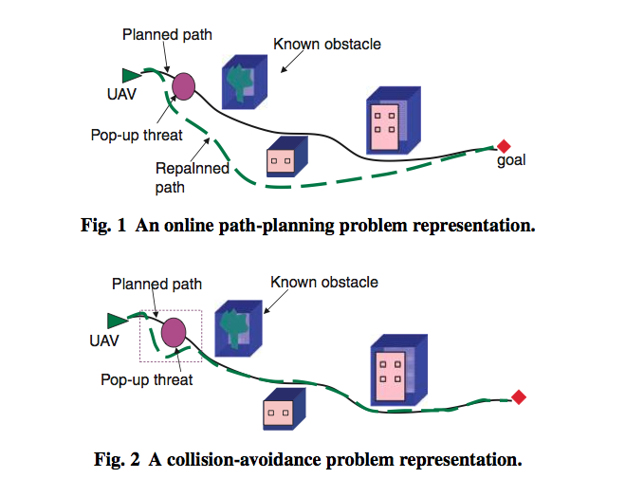
Notes
Include this type of picture in Chap 2:
On L:\\ drive for Math 605 has Dimensional analysis on how to scale a problem
Tell Chris Arendt about IPOPT 57 in Matlab with DLL files
Ok treat ownship as point mass but lose FOV for sensor model
Chapter 3 put in all the Math…leverage GNC abstract heavily
Take xx closest approaches and write about these.

